Slide 1
Sprint 2
Team D
Jianing Li

Slide 2
Structure
Client APP Server Database
Send Receive
Receive Send
Response to User
Primary Data
JSON
Exchange
&Calculate
Result

Slide 3
JSON vs XML
JSON
{
“SearchResult”:[
{“Name”:”Bill”,Address:”4500 City Ave”},
{“Name”:”Tom”,Address:”3671 City Ave”},
]}
XML
<searchresult>
<person>
<name>Bill</name>
<address> 4500 </address>
</person>
</searchresult>

Slide 4
JSON
Easy to read and write
Faster to transport
Analysis easier between Android and PHP
etc

Slide 5
Message in JSON
When the client want to communicate with the server, it sends a command and the JSON. Ex. “login”,”register”,”search”,”logout” with the attached JSON
The server uses the command to choose which part to run, reads the JSON, analysis and calculate, and send another JSON back
The client receive the JSON and jump to the corresponding page and show the info.

Slide 6
Advantage
We can develop dividedly. When testing, we just need to input JSON and read the output JSON instead of connected all the time.
It’s very easy to use JSON in PHP.

Slide 7
Sprint #2 Work
Last: login and register
Now: search a wish,if not searched, add a new wish. if searched, return the wish. Server Client
Next: Show the searched wishes.
Future: Ask for one of the wishes & agree him to enter
Topic designing is all the time.

Slide 8
Any Questions?

Slide 9
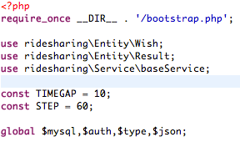
To check the user is online
Typical Server file: WishService.php
Every Service has a class with needed data
These 2 are used in all service
$type is the “command” referred before, $json is the JSON content

Slide 10

Initial the database, the class this server needs, and put JSON information into it.
In the $baseService, we have some functions to finish the basic SQL automatically.

Slide 11
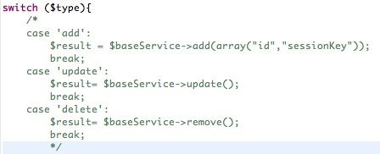
With the $type it chooses which service to do.
If finish these basic service, we can call the functions in $baseService to finish quickly and clearly.
(These codes are commented because we do not need them up to now. But maybe in future.)

Slide 12
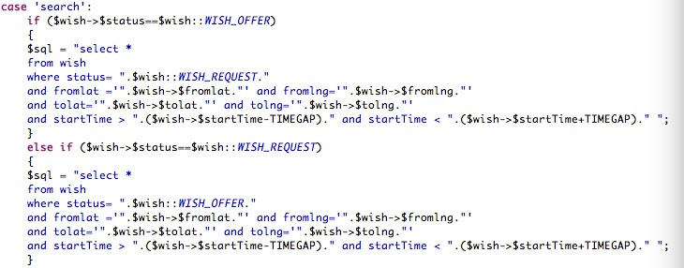
If the sql is too complex, we will design it manually.

Slide 13
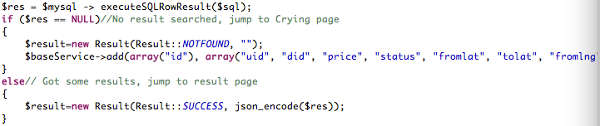

Create a Result class to write back to the Client app with the result symbol and the JSON info it needs.
Execute it
Everything is finished, disconnect the database and write back the JSON to the client. (the function is designed in bootstrap.php.)
Back

Slide 14
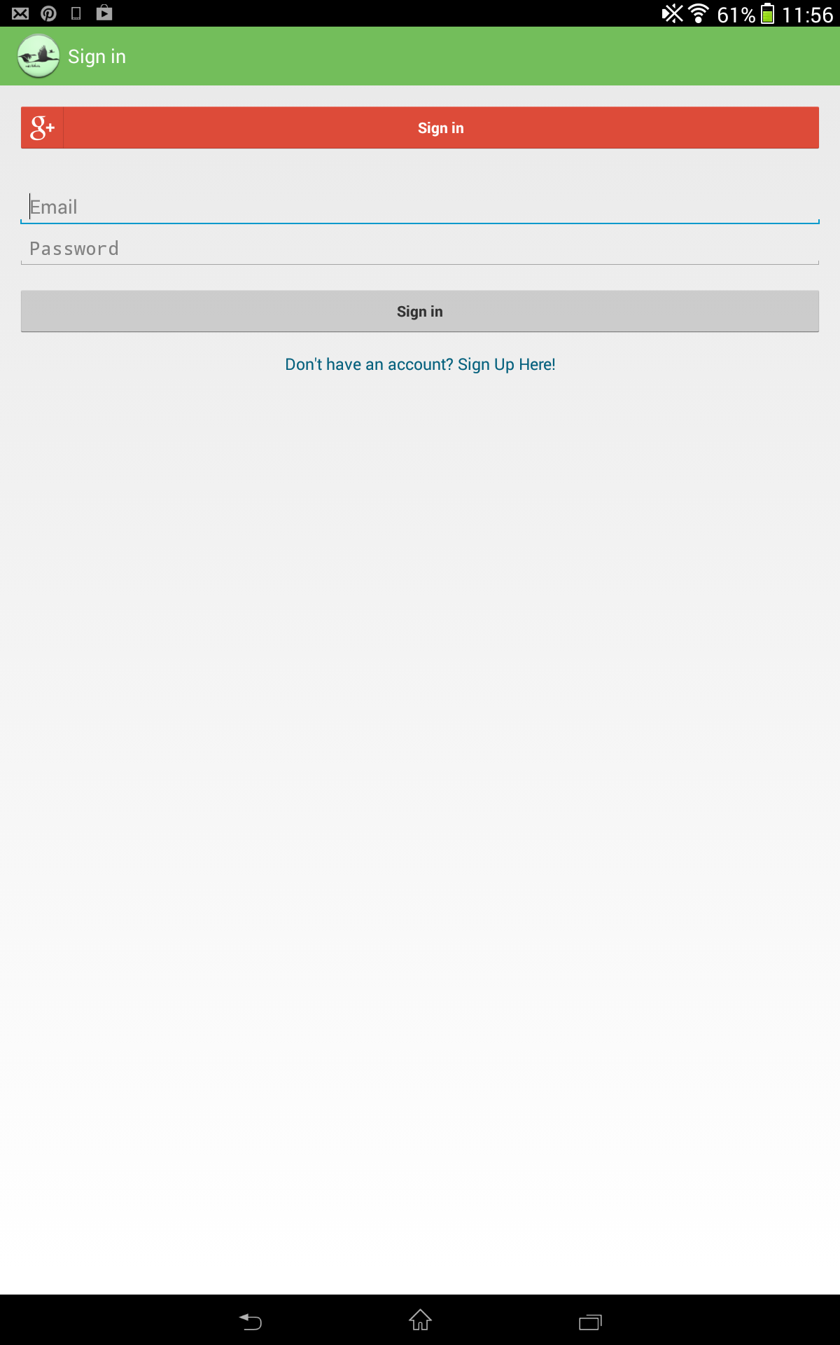
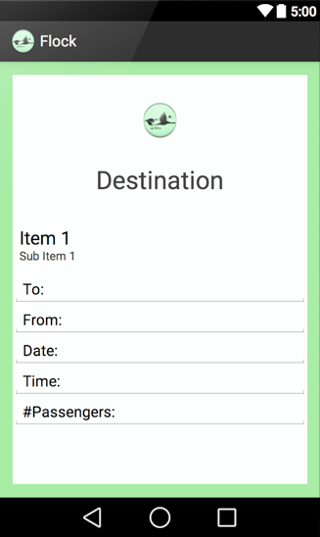
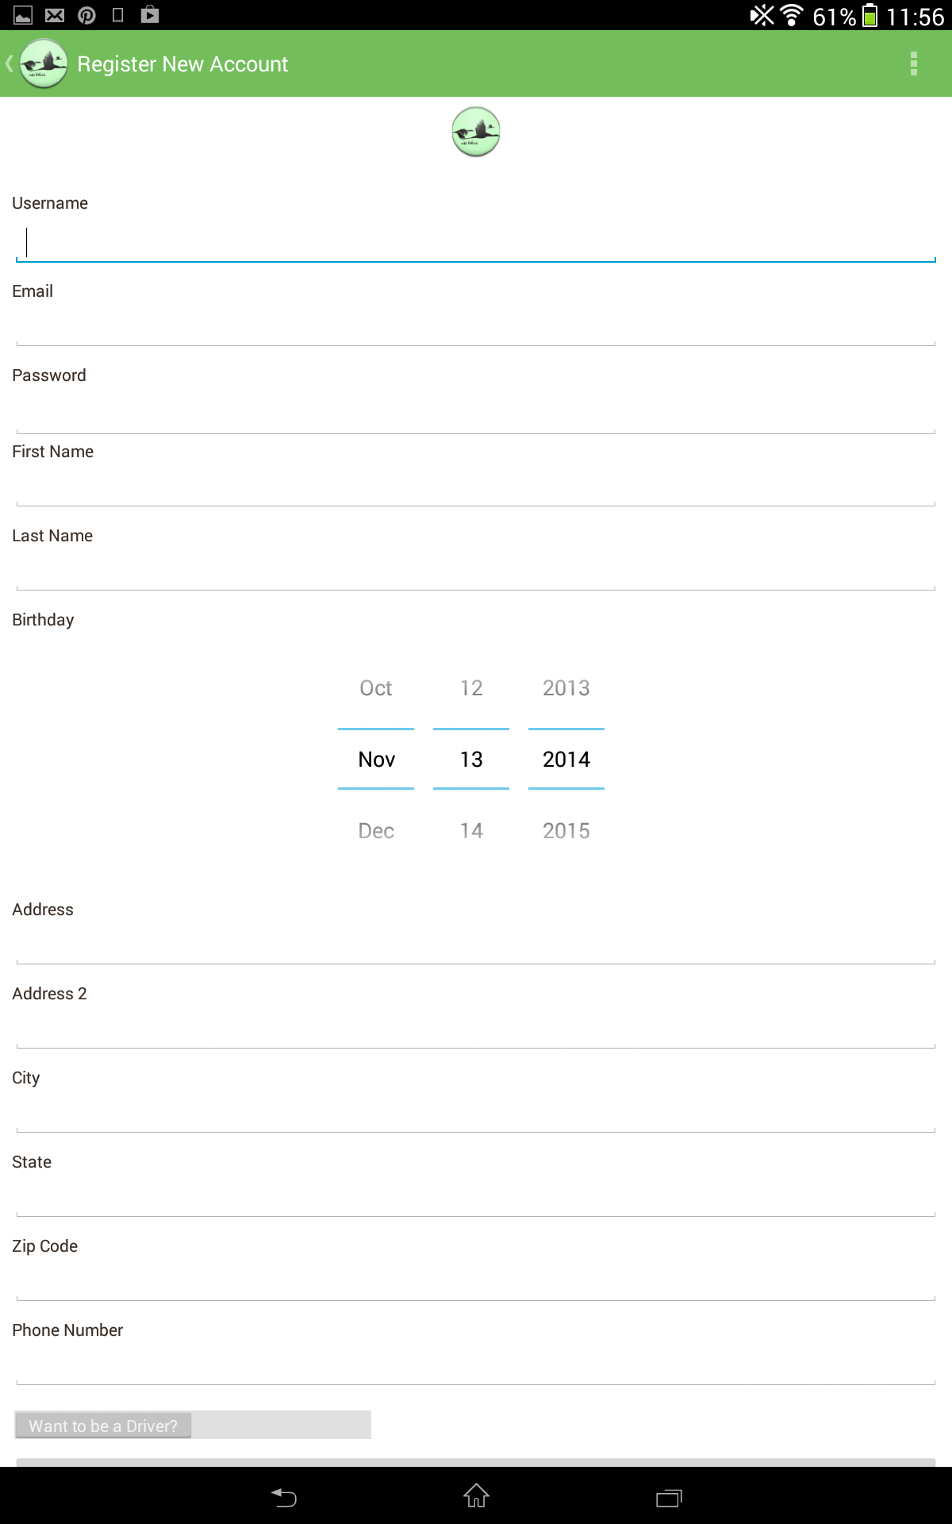
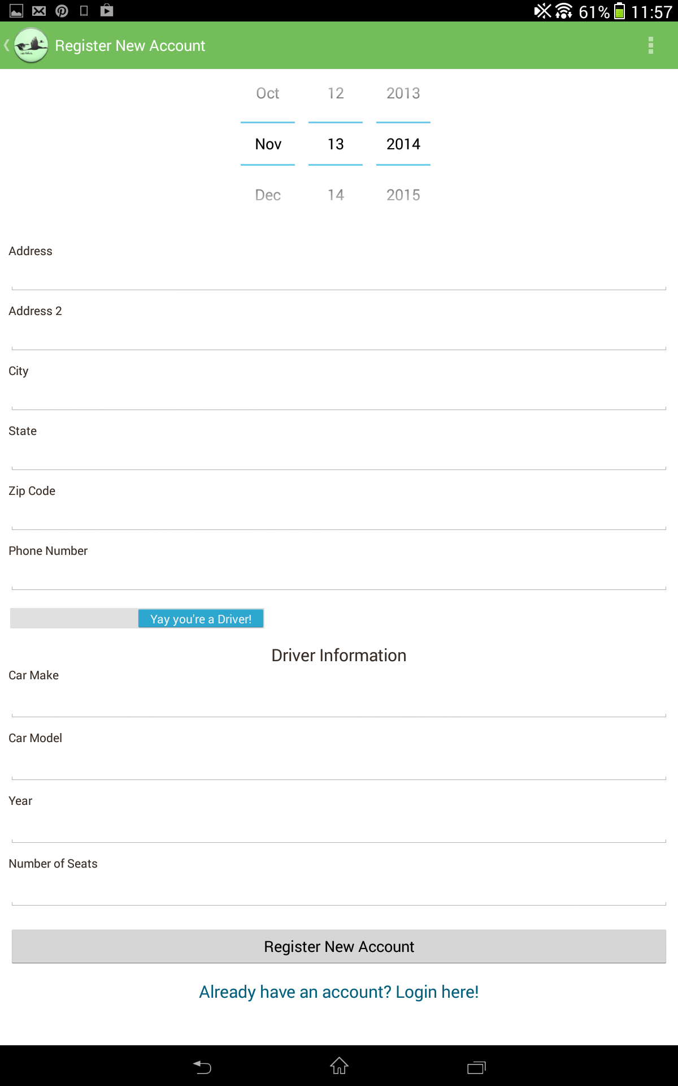

Slide 15
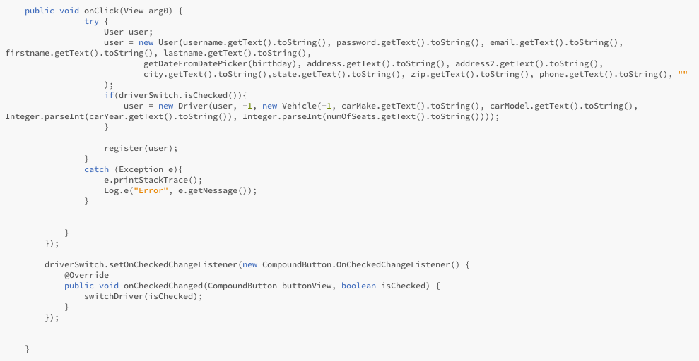
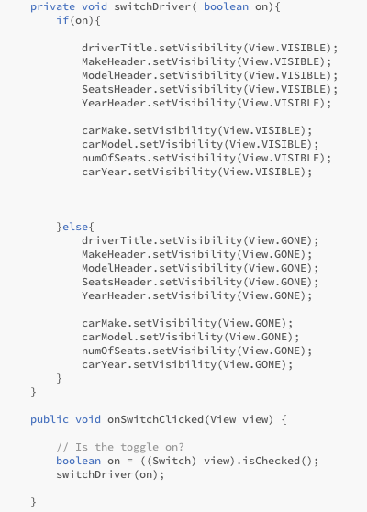
Call the related function to send the data in the JSON form to server
Create a class with all inputted data
Back

